Slide 1
When Intrusion Detection Meets Blockchain Technology: A Review
Alka Susan Sleeba
Class no:8 S7 BTech CSE
Dept of CSE MACE Kothamangalam
September 29 , 2018

Slide 2
CONTENTS
When Intrusion Detection Meets Block chain Technology: A Review
Introduction
Background on Intrusion Detection
Background on Blockchain Technology
Blockchain based Intrusion Detection
Challenges
Future Directions
Conclusion

Slide 3
INTRODUCTION
When Intrusion Detection Meets Block chain Technology: A Review
What is Intrusion Detection?
Categories of IDS :based on,
Deployed location
Detection approach
Proposes a system to enhance capability of single IDS
Blockchain introduced to mitigate challenges faced by CIDS

Slide 4
INTRUSION DETECTION
When Intrusion Detection Meets Block chain Technology: A Review
Two main functions of an IDS:
Information recording
Monitors target object
Record information
Alert generation
Inform security administrator

Slide 5
INTRUSION DETECTION(contd..)
When Intrusion Detection Meets Block chain Technology: A Review
IDS implemented in different types of network
Based on deployed location
Network based intrusion detection system
Monitors a network segment
Host based intrusion detection system
Monitors a single system

Slide 6
INTRUSION DETECTION(contd..)
When Intrusion Detection Meets Block chain Technology: A Review
Based on detection approach
Signature based IDS
Kind of pattern describing known attack
Compares stored signature with observed system
Anomaly based IDS
Has pre-built a normal profile
Identify deviations between normal and observed events

Slide 7
INTRUSION DETECTION(contd..)
When Intrusion Detection Meets Blockchain Technology: A Review
However, single IDS not effective
Design of CIDS
Two major issues of CIDS

Slide 8
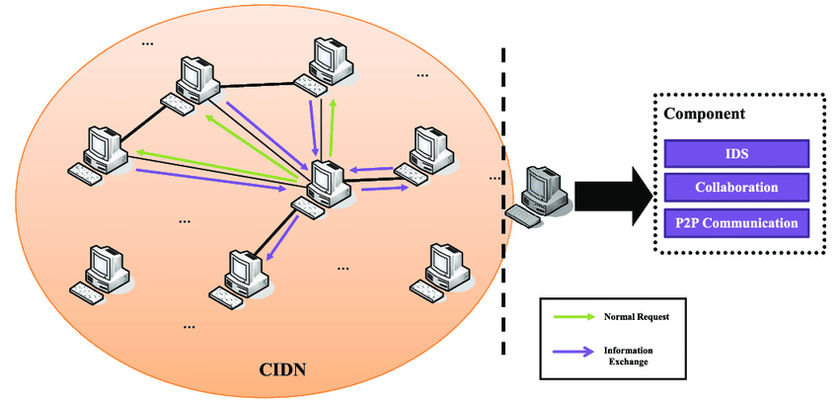
COLLABORATIVE INTRUSION DETECTION
When Intrusion Detection Meets Blockchain Technology: A Review
Courtesy : https://www.researchgate.net/figure/The-typical-architecture-of-a-collaborative-intrusion-detection-network_fig4_322814269

Slide 9

BLOCKCHAIN TECHNOLOGY
When Intrusion Detection Meets Blockchain Technology: A Review
Contents of a block
Courtesy :https://www.google.co.in/search?biw=1242&bih=525&tbm=isch&sa=1&ei=AnytW4KMMMT1vATPj7_oCg&q=hash-example.png&oq=hash-example.png&gs

Slide 10
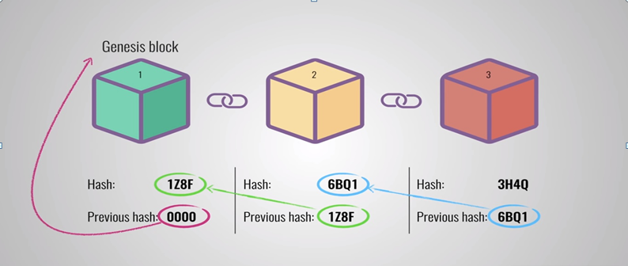
BLOCKCHAIN TECHNOLOGY(contd..)
When Intrusion Detection Meets Blockchain Technology: A Review
Courtesy: https://codingislove.com/simple-blockchain-javascript/

Slide 11
BLOCKCHAIN TECHNOLOGY (contd..)
When Intrusion Detection Meets Blockchain Technology: A Review
CRYPTOGRAPHIC HASH FUNCTIONS
security requirements :
Preimage resistance
given: hash value h
find x , H(x)=h
Second preimage resistance
given : x, h
find x’ , H(x’)=h
Collision resistance
given : h, h’
find x , x’

Slide 12
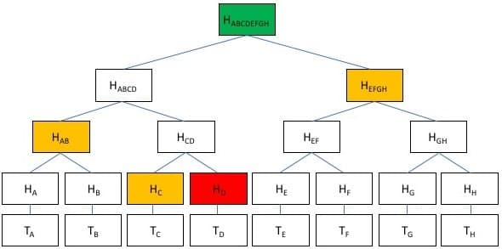
BLOCKCHAIN TECHNOLOGY (contd..)
When Intrusion Detection Meets Blockchain Technology: A Review
Merkle tree
Courtesy: https://www.mycryptopedia.com/merkle-tree-merkle-root-explained/

Slide 13
BLOCKCHAIN TECHNOLOGY (contd..)
When Intrusion Detection Meets Blockchain Technology: A Review
Tree of hashed values
Leaf node : hash of block data
Non-leaf node : hash of its children
Results in a single hash : Merkle root
Binary hash tree
Provides validity of data

Slide 14
BLOCKCHAIN TECHNOLOGY (contd..)
When Intrusion Detection Meets Blockchain Technology: A Review
Types of blockchain
Permissionless blockchain
Bitcoin
Permissioned blockchain
Hyperledger

Slide 15
BLOCKCHAIN TECHNOLOGY (contd..)
When Intrusion Detection Meets Blockchain Technology: A Review
Consensus protocols
Proof of work (pow)
Nodes solve cryptographic puzzle
Large mining farms build
Proof of stake (pos)
One node chosen to validate block
Node has to deposit coins as stake

Slide 16
When Intrusion Detection Meets Blockchain Technology: A Review
BLOCKCHAIN TECHNOLOGY (contd..)
Applications
Cryptocurrency economy
Enables huge transactions without government involved
Smart contracts
Automatically enforced by computer protocols

Slide 17
BLOCKCHAIN BASED INTRUSION DETECTION
When Intrusion Detection Meets Blockchain Technology: A Review
Blockchain based solutions for challenges in CIDS
Data sharing : caused by two requirements
Mutual trust
Data privacy
Trust computation
Raw alerts considered as transactions in a blockchain
Nodes adopt consensus protocol

Slide 18
BLOCKCHAIN BASED INTRUSION DETECTION (contd..)
When Intrusion Detection Meets Blockchain Technology: A Review
Scope of application for blockchains
Determines :
whether blockchain is required
which type of blockchain

Slide 19
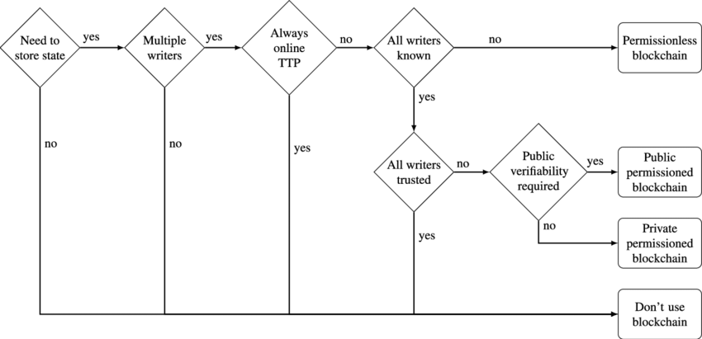
BLOCKCHAIN BASED INTRUSION DETECTION (contd..)
When Intrusion Detection Meets Blockchain Technology: A Review
Courtesy: https://www.researchgate.net/figure/Schematic-decision-diagram-according-to-31-to-determine-whether-a-blockchain-and-if_fig7_322814269

Slide 20
CHALLENGES
When Intrusion Detection Meets Blockchain Technology: A Review
Challenges faced by IDS
Limited Signature Coverage
Performance based on number of deployed signatures
Inaccurate Profile Establishment
Difficult to build normal profile
Massive False Attacks
Due to immature signatures and inaccurate profiles

Slide 21
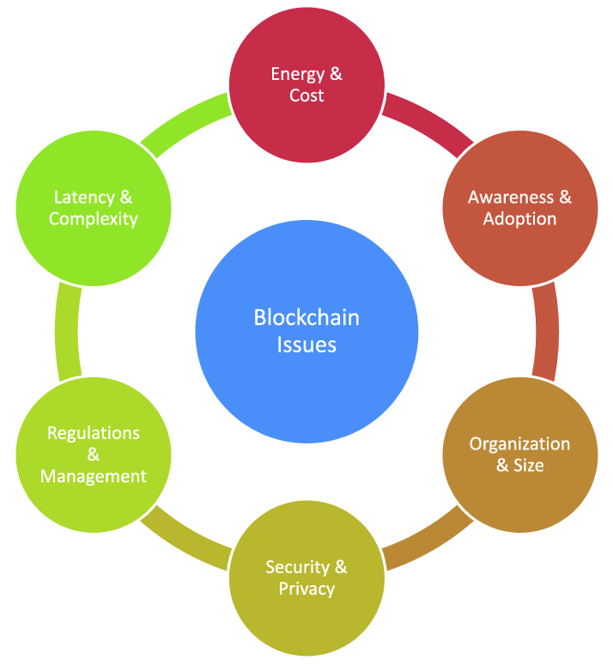
CHALLENGES (contd..)
When Intrusion Detection Meets Blockchain Technology: A Review
Challenges Faced by Blockchain technology
Courtesy: https://www.researchgate.net/figure/Blockchain-technology-challenges-and-limitations_fig8_322814269

Slide 22
CHALLENGES (contd..)
When Intrusion Detection Meets Blockchain Technology: A Review
Energy and Cost
Eg : bitcoin mining
Security and Privacy
Attractive target for cyber criminals
Awareness and adoption
Understanding how it works

Slide 23
CHALLENGES (contd..)
When Intrusion Detection Meets Blockchain Technology: A Review
Organization and size
Increased size of ledger, performance degrade
Latency and complexity
Transaction take long to finish

Slide 24
FUTURE DIRECTIONS
When Intrusion Detection Meets Blockchain Technology: A Review
Block chains more focused on :
Data Sharing : enforces trust and data privacy among parties
Alert Exchange
Trust Computation : alerts used to evaluate trustiness of nodes

Slide 25
CONCLUSION
When Intrusion Detection Meets Blockchain Technology: A Review
Increase in cyber-attacks
demand for collaboration between the defenders
Blockchain technology
emerging solution for decentralized transactions
Blockchains , potential impact on improvement of CIDS
However , challenges are inevitable

Slide 26
REFERENCE
When Intrusion Detection Meets Block chain Technology: A Review
N. Alexopoulos, E. Vasilomanolakis, N. R. Ivanko, M. Muhlhauser, "Towards blockchain-based collaborative intrusion detection systems", Proc. Int. Conf. Critical Inf. Infrastruct. Secur., pp. 1-12, 2017.
C. Badertscher, U. Maurer, D. Tschudi, V. Zikas, "Bitcoin as a transaction ledger: A composable treatment" in Advances in Cryptology—CRYPTO, Heidelberg, Germany:Springer, vol. 10401, pp. 324-356, 2017. 3. B. Chun, J. Lee, H. Weatherspoon, B. N. Chun, "Netbait: A distributed worm detection service", 2003. Show Context
C. Duma, M. Karresand, N. Shahmehri, G. Caronni, "A trust-aware P2P-based overlay for intrusion detection", Proc. DEXA Workshop, pp. 692-697, 2006.
C. J. Fung, O. Baysal, J. Zhang, I. Aib, R. Boutaba, F. De Turck, W. Kellerer, G. Kormentzas, "Trust management for host-based collaborative intrusion detection" in Managing Large-Scale Service Deployment, Heidelberg, Germany:Springer, vol. 5273, pp. 109-122, 2008.
F. Gong, Next generation intrusion detection systems (IDS), Santa Clara, CA, USA, 2003.
A. K. Ghosh, J. Wanken, F. Charron, "Detecting anomalous and unknown intrusions against programs", Proc. Annu. Comput. Secur. Appl. Conf. (ACSAC), pp. 259-267, 1998.
R. Huebsch et al., "The architecture of PIER: An Internet-scale query processor", Proc. Conf. Innov. Data Syst. Res. (CIDR), pp. 28-43, 2005.
G. Wood, Ethereum: A Secure Decentralised Generalised Transaction Ledger, 2016.
W. Li, Y. Meng, L.-F. Kwok, H. H. S. Ip, "PMFA: Toward passive message fingerprint attacks on challenge-based collaborative intrusion detection networks", Proc. 10th Int. Conf. Netw. Syst. Secur. (NSS), pp. 433-449, 2016.
M. Mettler, "Blockchain technology in healthcare: The revolution starts here", Proc. 18th Int. Conf. e-Health Netw. Appl. Services (Healthcom), pp. 1-3, Sep. 2016.
K. Wüst, A. Gervais, "Do you need a blockchain?", pp. 375, 2017,.

Slide 27
REFERENCE(Contd..)
When Intrusion Detection Meets Block chain Technology: A Review
M. Roesch, "Snort: Lightweight intrusion detection for networks", Proc. USENIX Lisa Conf., pp. 229-238, 1999.
A. Rutkin, Blockchain-Based Microgrid Gives Power to Consumers in New York, [online] Available
K. A. Scarfone, P. M. Mell, "Guide to Intrusion Detection and Prevention Systems (IDPS)", 2007. 18. S. R. Snapp et al., "DIDS (distributed intrusion detection system)—Motivation architecture and an early prototype", Proc. 14th Nat. Comput. Secur. Conf., pp. 167-176, 1991. Show Context
J. Sotos, D. Houlding, Blockchains for data sharing in clinical research: Trust in a trustless world, Santa Clara, CA, USA, 2017. 20. L. Wang, Y. Liu, J. Mirkovic, Y. Liu, "Exploring miner evolution in bitcoin network" in Passive and Active Measurement, Heidelberg, Germany:Springer, vol. 8995, pp. 290-302, 2015. 21. Y.-S. Wu, B. Foo, Y. Mei, S. Bagchi, "Collaborative intrusion detection system (CIDS): A framework for accurate and efficient IDS", Proc. Annu. Comput. Secur. Appl. Conf. (ACSAC), pp. 234-244, Dec. 2003.

Slide 28
When Intrusion Detection Meets Block chain Technology: A Review
THANK YOU

